Slide 1


Third-Party Voter Registration Organization (3PVRO) Overview
FLORIDA
DEPARTMENT
of STATE
Secretary of State Laurel M. Lee
Maria Matthews, Esq., Division of Elections
Amber Marconnet, Assistant Director
Toshia Brown, Interim 3PVRO Contact
Updated May 28, 2021
(to reflect s. 7, chapter 2021-11, Laws of Florida)

Slide 2
Table of Contents
Section One: What is a 3PVRO?
Section Two: How to register as a 3PVRO?
Section Three: What to do as a 3PVRO?
Section Four: What constitutes non-compliance?
Section Five: Division of Elections’ and Supervisor of Elections’ Role
Section Six: Resources and Contact Information

Slide 3
What is a 3PVRO?
Section One

Slide 4
3PVRO
VRA
A 3PVRO is not the same as a VRA
Different governing laws and regulations apply

Slide 5
Activity – Collecting Applications
3PVRO
Not a 3PVRO
Any person or entity who collects one or more paper voter registration applications once or more often:
  Private individuals
  Non-profit corporations
  Political organizations
  Other groups
Reference: s. 97.0575, Fla. Stat., and Rule 1S-2.042, F.A.C.
Only distributes blank applications
Only collects applications from spouse, child, or parent
Is an employee or agent of:
          Division of Elections
          Supervisor of Elections
          Any office that issues driver license or state identification card
          Voter Registration Agencies (VRAs) designated by federal or state laws

Slide 6

Activity – Helping People Register
    3PVRO requirements do not apply when the voter submits their application directly through the official online voter registration website RegistertoVoteFlorida.gov , the Department of Highway Safety and Motor Vehicles’ online renewal system, or directly to supervisor of elections office
    3PVRO requirements do apply if person or entity collects printed or paper form from voter using RegistertoVoteFlorida.gov or downloadable form (English PDF/ Español PDF) or any other website and is not otherwise a spouse, child or parent

Slide 7
How to register as a 3PVRO?
Section Two

Slide 8
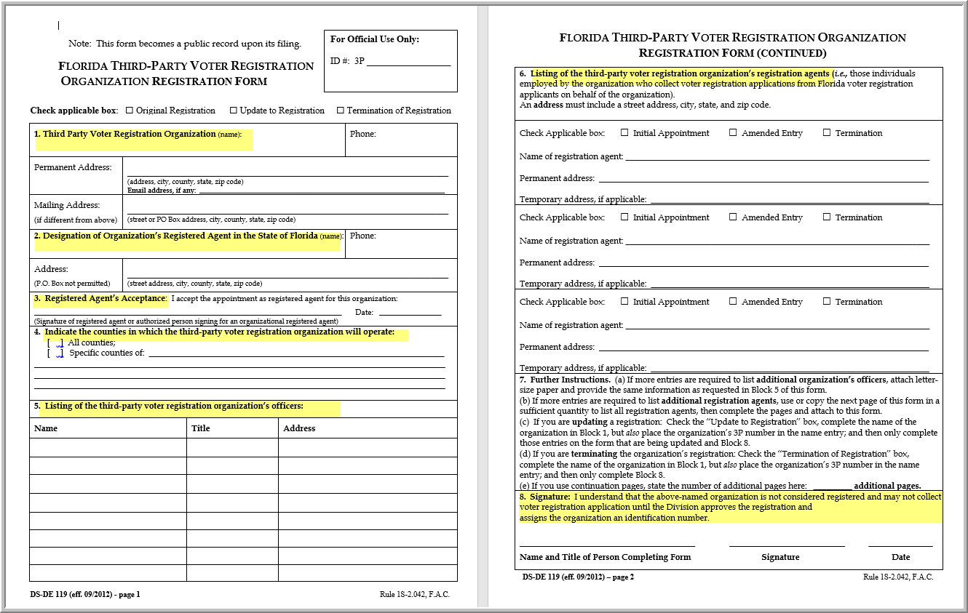
Register as 3PVRO
3PVRO assigned unique identifier
Submit Form DS-DE 119 to
Division of Elections

Slide 9
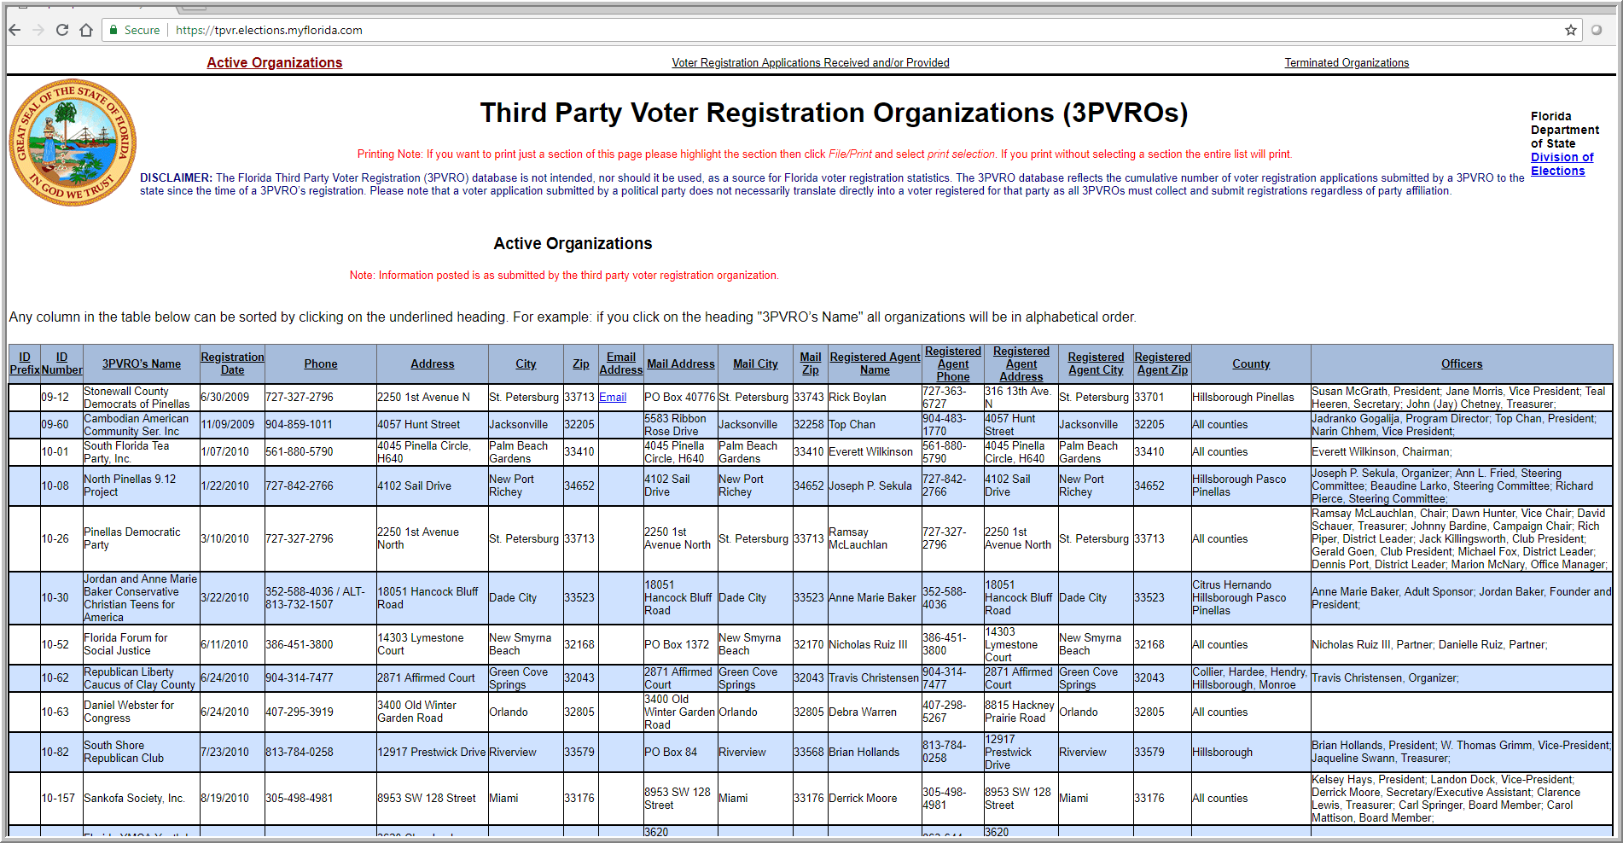
Public online database of registered 3PVROs

Slide 10
What to do as a 3PVRO?
Section THREE

Slide 11
Duties – When Collecting Paper Applications
Know the law and rules
Register as a 3PVRO if collecting applications
Obtain blank applications with assigned 3PVRO #
Timely submit collected voter registration applications:
    No later than the registration deadline for upcoming elections, or
    Within 14 days of collection, whichever is earlier
Include 3PVRO #
Date the backside of collected applications

Slide 12
3PVRO Duties – Update Information
Change in Registered Agent
Change in registration agents
Change in officers
Change in contact information
Change in status – closing or termination of activity
Notify the Division of Elections immediately
so records and public website are current

Slide 13
What constitutes non-compliance?
Section FOUR

Slide 14
Key Non-Compliance Activities
Failure to register as a 3PVRO
Failure to place unique 3PVRO identifier on back of collected application(s)
Failure to date back of collected application(s)
Failure to timely return collected application(s)
  No later than 14 days after date completed by voter (or date collected if voter does not date application), or
  By registration deadline (book closing) for an upcoming election, whichever is earlier

Slide 15
Primary responsibilities of 3PVRO registration agent
Submit application timely to the county in which the applicant resides
  i.e., No later than 14 days from date of application or date collected or no later than registration deadline.
Inform applicant that the organization might not deliver the application within 14 days or before registration deadline and let voter know that he or she may deliver the application in person or by mail
Tell the applicant how to register online with the Division
  i.e., RegistertoVoteFlorida.gov
Tell the applicant how to find out if application is delivered
  i.e., contact the Supervisor of Elections’ office in county where person seeks to register or is registered.

Slide 16
Consequences for Voter …
If application is untimely submitted or never submitted by 3PVRO:
    Voter is not registered for election
    Voter cannot vote
    Voter is not able to change party affiliation in time to vote for party race(s) in primary election
    Voter encounters problems at the polling place during Early Voting or Election Day

Slide 17
Consequences for 3PVRO . . .
Untimely return – more than 14 days after date signed or collected or bookclosing, whichever is sooner
Potential Fine $50/app
Willful - $250
Untimely return – after book closing for most recent state or local election
Potential Fine $100/app
Willful - $500
Failure to return
Potential Fine $500/app
Willful - $1000
Secretary of State Referral to Attorney General
upon reasonable belief that violation has occurred

Slide 18
Division of Elections’ and Supervisor of Elections’ Role
Section FIVE

Slide 19
Division of Elections’ Role
- Process request to register as 3PVRO
- Assign a newly registered 3PVRO a unique identifier #
- Provide blank applications requested by 3PVRO
- Provide 3PVRO power point training
- Maintain online database of 3PVROs and distributed/returned forms
- Verify 3VPRO name and assigned name on public 3PVRO database
- Process and forward returned 3PVRO voter registration applications to respective Supervisor of Elections
- Collect reports from SOEs and complaints
- Review 3PVRO non-compliance reports filed by SOEs
- Issue warning or refer for fine or further investigation

Slide 20
Supervisor of Elections’ Role
- Process requests for blank voter registration forms
(if volume is 10,000 or more refer request to DOE)
- Write or stamp 3PVRO ID# on reverse side of apps BEFORE distribution
- Process all returned applications (even if untimely returned)
- Date/Time stamp and receiver’s initials on back of application
- New registration date is determined same way as for any other application mailed or hand-delivered. See s. 97.053(5), F.S.
- Complete Form DS-DE 124 to account for distribution and return of application forms
- Report to State 3PVRO non-compliance (Form DS-DE 148)
- Courtesy contact to applicants whose applications were untimely submitted
- Conduct outreach to 3PVROs

Slide 21
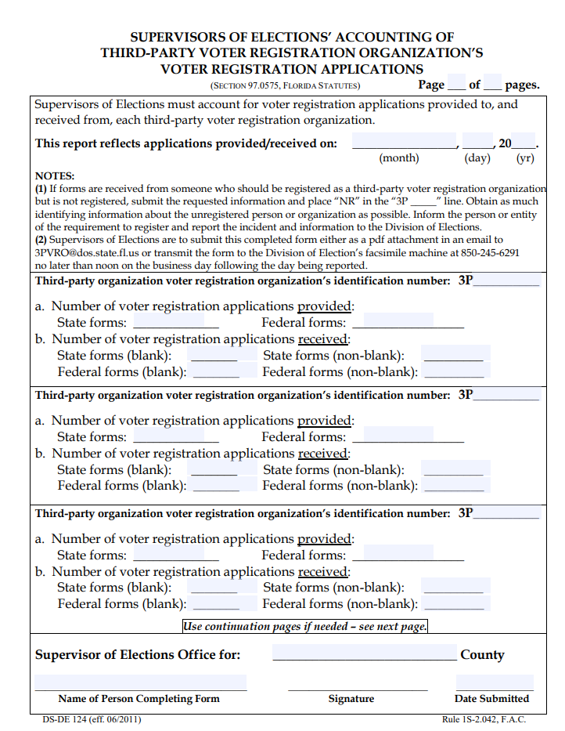
Form for
Supervisors
DS-DE 124 -
  Accounts for distribution of blank forms and return of voter registration forms
  Each supervisor of elections shall report to the Division on Form DS-DE 124 by noon of the following business day the number of voter registration applications provided to and received from each organization the previous business day

Slide 22
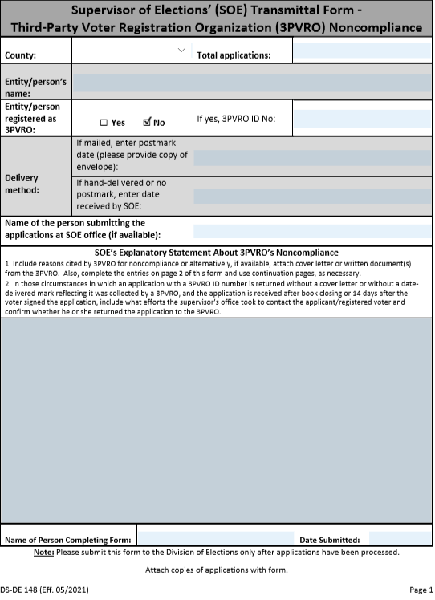
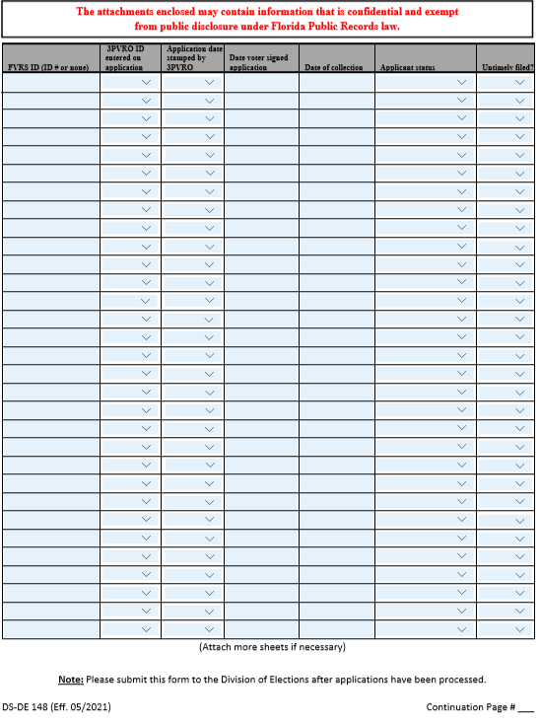
Form for Supervisors to Report 3PVRO Non-compliance
DS-DE 148 - Non-Compliance

Slide 23
Resources and Contact Information
Section SIX

Slide 24
How to get blank paper applications?
Available online to download and print paper applications and print 3PVRO# on applications
Request from Supervisor of Elections Offices or Division of Elections’ Office
Free for requests up to 9,999
1 cent per application for requests for 10,000 or more
  (Based on history of requests since 1st request by 3PVRO) For number of requests to date, visit 3PVRO website at: https://tpvr.elections.myflorida.com/Applications.aspx
  For non-3PVRO groups, contact the Division of Elections

Slide 25
Who to Contact for Assistance?
Toshia Brown, Interim Contact
      Toshia.Brown@DOS.MyFlorida.com
      850-245-6225
      Registration as a 3PVRO
      Process of SOE daily 3PVRO accounting reports
      Training
Jason Merrick, Interim Coordinator for Application Orders
      Jason.Merrick@DOS.MyFlorida.com
      Requests for blank paper applications

Slide 26
3PVRO Resources
3PVRO Division Webpage: https://dos.myflorida.com/elections/for-voters/voter-registration/third-party-voter-registration-organizations
      Database of current and terminated 3PVROs: https://tpvr.elections.myflorida.com
      Reference guideline on 3PVROs (DE 0012): https://dos.myflorida.com/media/704338/de-guide-0012-third-party-voter-registration-organizations.pdf

Slide 27

FLORIDA
DEPARTMENT
of STATE
For more information, visit us online at:
dos.myflorida.com/elections

